Slide 1









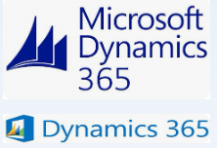


Cloud Automation Landscape
An illustrative high level test architecture for a sample program is presented below. This will need to be customized based on specific needs and constraints of the specific client environment.
Illustrative
Test Automation Architecture
Test Case and
scripts automation
Common
libraries
Utility
Libraries
Application specific libraries
^{Configuration}
for repeatability and
regression testing
files
Automated Test Suite
Automated Test
Execution
Results
CI/CD
Cloud Infra testing, Application Automation, Data Validation, Accessibility Testing
Automation Script Pipeline
Build/ Release
Pipeline 1
Playwright Test Automation
Pipeline 2
Triggers
Integrated Test
Management
Pipeline N
Application integration Data Integration Batch Integration
Requirements
Input Test Data
Config. Repository
Reports
Feature Files
Test Scenarios
XLS ^{Database}
FilesObjectsServers
Test environment and
test configuration
automation for
Repeatability for future
integrations
Test Environment Configuration
Step Definition
Application Under Test
Cloud –AWS,Azure
Web Application
Databases

